Slide 1
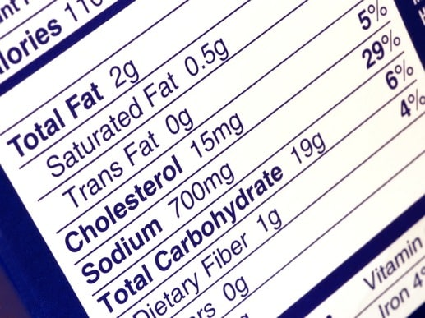
NUTRITION CONTENT DASHBOARD
TEAM MEMBERS:
B.VISHWAMBHAR
G.APOORVA
G.HARSHAVARDHAN
G.SAI RAM
G.VINAY REDDY

Slide 2
Nutrition plays a great role in our daily life. The food or liquids affect our body and health because each food or liquid contain particular nutrition which is very necessary for our physical and mental growth. A particular level of any particular nutrition is essential for our body.

Slide 3
Due to the improvement in people's standards of living, obesity rates are increasing at an alarming speed and this is reflective to the risks in people's health. People need to control their daily calorie intake by eating healthier foods, which is the most basic method to avoid obesity.
In this covid pandemic situation people are more inclined towards healthy food and concentrating more on their food intake and maintaining healthy habits to lead a healthy life.

Slide 4
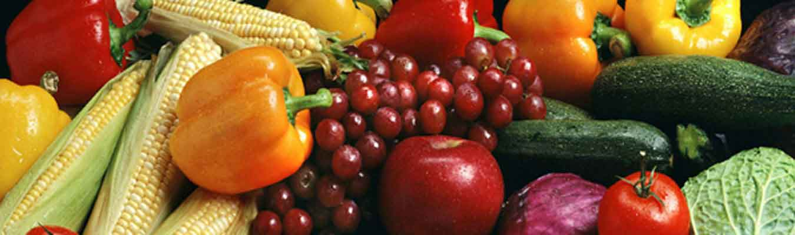
Although food packaging comes with nutrition (and calorie) labels, it’s still not very convenient for people to refer. App-based nutrient dashboard systems which can analyze real-time images of the meal and analyze it for nutritional content can be very handy and improve the dietary habits, and therefore, result in a healthy life.

Slide 5
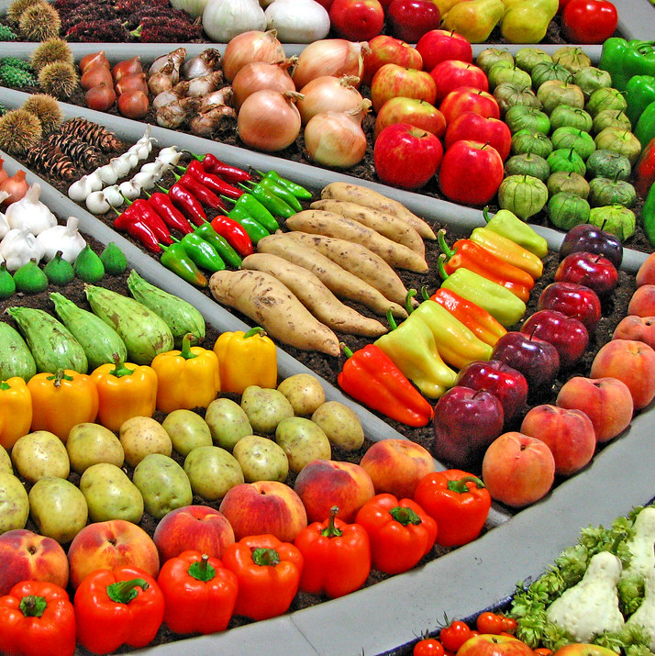
Creating an Nutrition Image Analysis Dashboard:
Now there are lot of sources available in internet where we can browse the nutrition content in the food. But there is no such website which can actually give the nutrition by analyzing the food image. For this we have created an app which automatically estimates food attributes such as ingredients and nutritional value by classifying the input image of food.

Slide 6
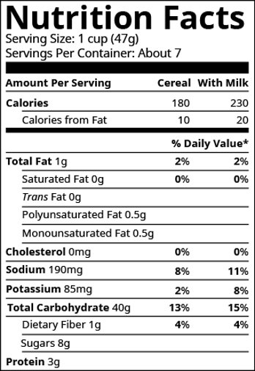
Aim: To build a web app to find and analyze the Nutrition Content of a food image.
Due to the improvement in people’s standards of living, obesity rates are increasing at an alarming speed, and this is reflective to the risks in people’s health. People need to control their daily calorie intake by eating healthier foods, which is the most basic method to avoid obesity. However, although food packaging comes with nutrition (and calorie) labels, it’s still not very convenient for people to refer. App-based nutrient dashboard systems which can analyze real-time images of the meal and analyze it for nutritional content can be very handy and improve the dietary habits, and therefore, result in a healthy life.

Slide 7
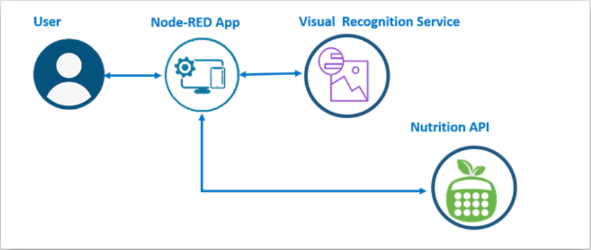
Technical Architecture:

Slide 8
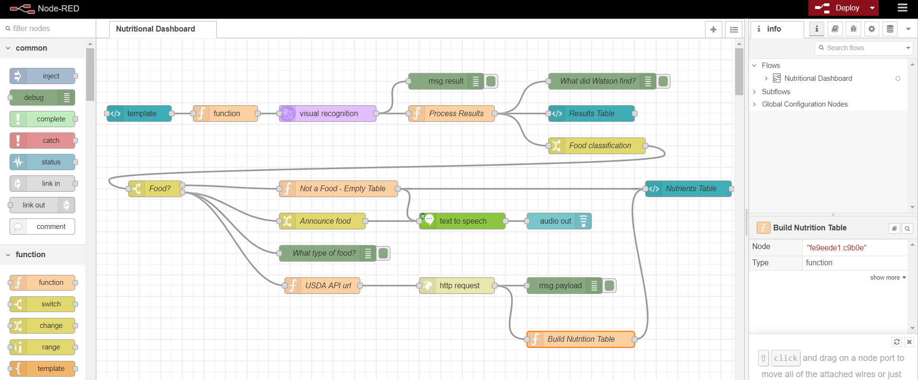
NODE-RED FLOW:

Slide 9
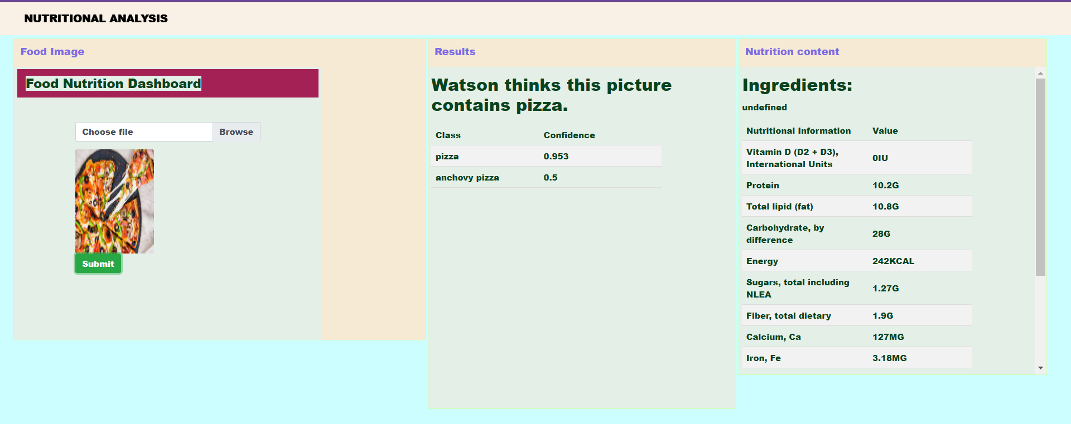
NUTRITIONAL ANALYSIS DASHBOARD-FOR A FOOD IMAGE: When we give an image as input it will classify the image as food or non-food. If it is a food item, it identifies and reads out the name of the food item with its calculated Nutrition Content.

Slide 10
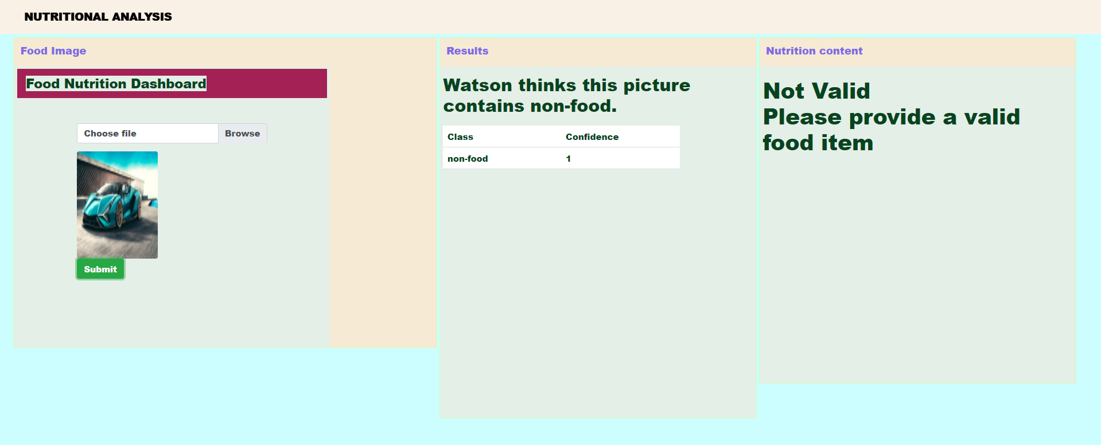
NUTRITIONAL ANALYSIS DASHBOARD-FOR A NON-FOOD IMAGE: When we give an image which contains non-food, it identifies the image and reads out that the image contains a non-food item and also asks us to provide an valid food image.

Slide 11
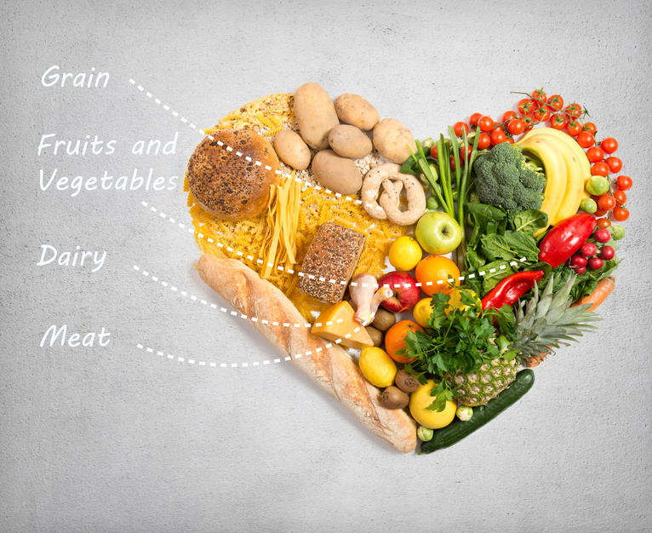
Thank you...

